Slide 1
TAP Lab at TCNJ

Slide 2
Are you interested in…
…working on a wide variety of projects?
…gaining hands-on experience with data collection, entry, analysis, and employing psychological measures?
…petting dogs?
Then this could be the lab for you!

Slide 3
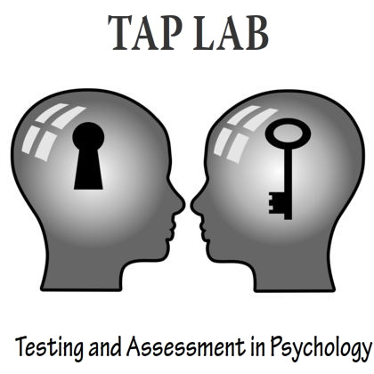
Who are we?

Slide 4
Dr. Jean Kirnan
Specialization: Industrial and Organizational
Research focus: assessment and ethics
Registered therapy dog handler

Slide 5
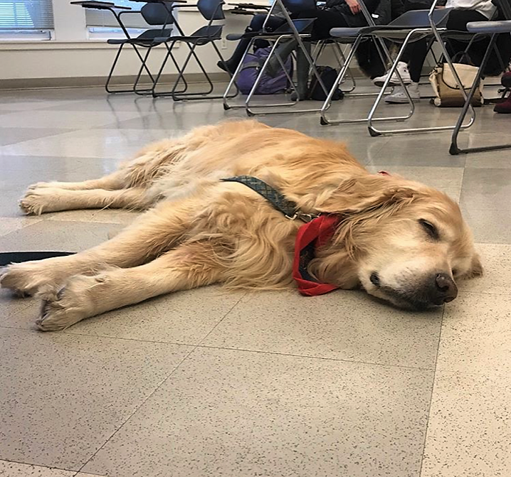
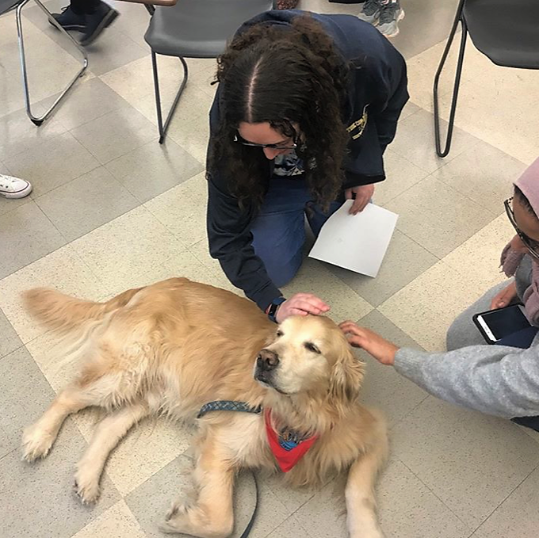
Bob

Slide 6
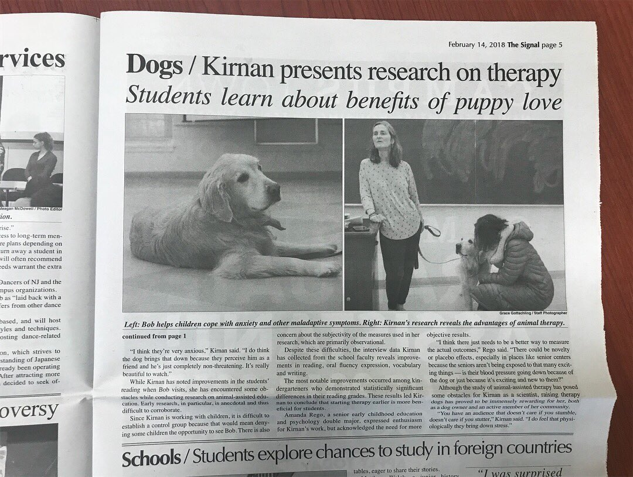
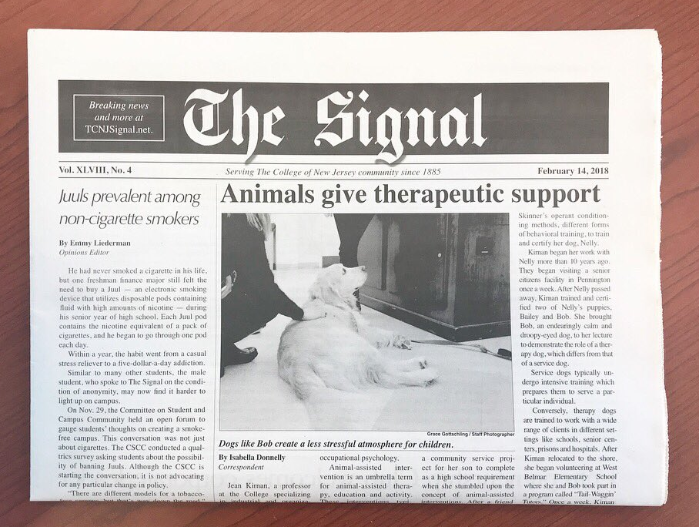
We’re in the paper!

Slide 7
Current Projects
Predictors of Academic Success of Students (PASS)
Predictor of first-year college success
Personality, Perception, and Judgment
Relationship between personality traits and the way we see and respond to situations
Animal-Assisted Interventions
Analyzing archived data from dog-assisted literacy program
Investigation of other AAI sites

Slide 8
How can you join?
Complete PSY 121
Recommended PSY 203
Majors, minors, and double-majors all welcome!

Slide 9
Thanks!
Any questions?
You can also contact Dr. K at jkirnan@tcnj.edu

