Slide 1
Tail Waggin’ Tutors: Effects of Dogs on Reading Scores
By Bridget Anton,
Christina Guentert,
Hannah Krotulis

Slide 2
Introduction
Animals shown to have a positive influence on human functioning
Animals offer various benefits to humans
Lower blood pressure, stronger immunity, positive mood
These benefits seen in Animal Assisted Activity (AAA) and Animal-Assisted Therapy (AAT).

Slide 3
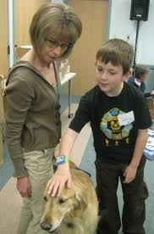
Introduction
Animal-Assisted Therapy (AAT): utilizes animals in treatment in order to accomplish predetermined goals and outcomes for individuals
Dogs provide patients with sense of comfort, well-being, and
emotional support
Dogs can be used in a variety of domains (hospitals, nursing homes, schools) to foster healing, self-acceptance, and learning

Slide 4
Introduction
AAT in schools
Country-wide reading programs involving dogs have shown positive results
Sit, Stay, Read in Chicago has participants increase their reading skills by reading 24 words per minute
R.E.A.D. resulted in an increase of students reading ability by two grade levels after completion of the program

Slide 5
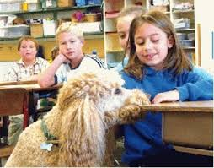
Introduction
Dogs in school settings
Children who struggle to keep up with their peers in reading often anxious and self-conscious when asked to read out loud
Reading becomes a chore rather than an enjoyable activity
Presence of dogs has been shown to
provide emotional support and comfort

Slide 6
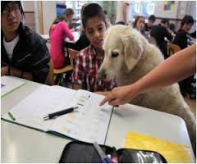
Introduction
AAT Reading Programs
Tail Waggin’ Tutors
A handler brings a dog into the classroom, in which children take turns reading aloud to the animals
This is the program used in our study

Slide 7
Hannah’s Study
The United States has a large immigrant population
Children growing up in homes that speak primarily in their native language are put at a disadvantage in the school system
There is a language barrier between the U.S. education system and immigrant parents, which can have a large impact on students living in ESL homes

Slide 8
Hannah’s Study
Children with siblings are shown to have great social and behavioral benefits
Siblings provide support for one another
Academically and linguistically

Slide 9
Hannah’s Study
ESL students face higher rates of anxiety and are subject to internalizing negative thoughts about themselves
Dogs can provide the “unconditional” support and acceptance needed for them to feel comfortable

Slide 10
Bridget’s Study
* The children considered at-risk in this study were defined by my operational definition of at-risk: Students within in each grade level who fell one standard deviation below the mean of RIT sheet

Slide 11
Research Questions
Do reading scores improve with TWT compared to without TWT?
Are 2 years of TWT conducive to increasing reading scores as compared to 1 year of TWT and 0 years of TWT?
Is TWT effective for at-risk students?

Slide 12
Research Questions
Do ESL students participating in the TWT reading program have higher reading scores than ESL students who did not participate?
Do ESL students who live with school aged siblings have higher reading scores than those who do not?
Does the degree of English spoken in households positively correlate with reading scores?

Slide 13
Method
Participants
* K-4 from an Elementary School in NJ
* 487 records
* About 160 children in grades K-4.
* Gender: 50.9% Males and 49.1% Females
* Ethnicity: 72.9% Caucasian, 0% African American, 5.7% Asian American, 17.9% Hispanic

Slide 14
Method
Materials
NWEA Achievement Reading Test
Routinely administered to children at the school every fall, winter, and spring
Kindergarten does not take it in the fall
Test-retest across the span of 7-12 months reading reliability ranging from low .80s to low .90s
Content validity through mapping curriculum standards (Arizona Instrument to Measure Standards, Colorado Student Assessment Program) with the NWEA test blueprint
Criterion validity with Pearson correlations ranging from .66 to .87

Slide 15
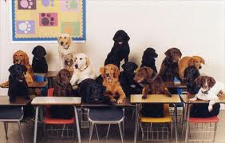
Method
Procedure
Therapy dog and handler enter classroom
Introduction of dog to classroom depends on teacher
After greeting, dog and handler sit on reading carpet and students break into groups of 3-6

Slide 16
Method
Procedure
Each group gets chance to sit on carpet and read to dog
Students are given a book that corresponds to group’s reading level; each student takes a turn reading 1 page until book is finished
About 10-20 minutes

Slide 17
Method
Procedure
Interpreting data:
Accessed archival data (reading test scores provided by school from NWEA Achievement Level Test administered 3 times/year)
Every child in school participated in reading program (grades K-5)

Slide 18
Results: Bridget
A 2 x4 analysis of variance of reading score was conducted
* No main effect for reading program was found F (1, 315) = 1.14
* There was a main effect for grade, F (4, 315) = 126.43, p < .001.
* No main effect for reading program was found F (1,30) = 0.01, p = .942.
* There was a main effect for grade, F (3,30) = 16.94, p < .001.
* Interaction of Reading Program and Grade was NOT significant, F (3,30) = 0.31, p= .820

Slide 19
Results: Christina
Year 1: No significant difference between reading scores of students in the TWT group (M = 192.19) and those in control group (M = 189.47)
Main effect for grade: as age increases, so does reading development
Interaction between TWT participation and grade was significant (comparison of TWT and control group within each grade)
Only interaction which even approaching significance was in kindergarteners participating in TWT (M = 169.96) vs those in control group (M = 159.76), where p = .108.
Notes:
This may suggest that TWT is effective in improving reading scores at younger ages, but not as effective at older ages

Slide 20
Results: Christina
Year 2: Significant difference between reading scores of students in TWT group (M = 194.73) vs. control group (M = 189.47) yielding a main effect (F(1,303)=4.34, p = .038, partial η² = 0.014)
Only interaction which was significant was comparison of kindergarteners participating in TWT (M = 171.85) vs. those in control group (M = 159.76), where p = .049
Interaction comparing first graders who participated in TWT (M = 186.15) with those in control group (M = 176.34), where p = .089 approached significance

Slide 21
Results: Hannah
ESL Reading Scores
Main effect for grade, but not for the TWT program. Reading scores increased with grade level F(4, 45) = 26.21, p < .001.
Significant interaction of the TWT reading program and grade F(4, 45) = 3.98, p = 009.
Only Kindergarten showed significance
These differences between the control and experimental groups lessen as grades get higher.

Slide 22
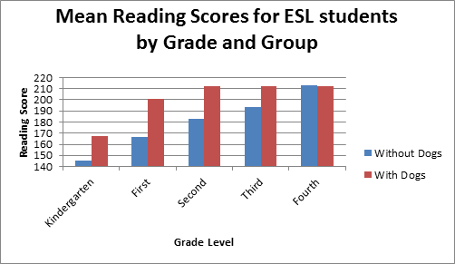
Results: Hannah

Slide 23
Results: Hannah
Number of Siblings and English Proficiency
Due to small cell sizes, results were not reliable
Marginally significant results for high fluency of English spoken in the home, F(1, 24) = 3.37, p = .076
Started off with 24 students, which were further divided into subcategories

Slide 24
Discussion: Bridget
* As predicted, there was a main effect for grade
* The data findings didn’t support my hypothesis of at-risk students’ reading scores increasing due to the TWT program
* One reason behind this could be because of my original operational definition of ‘at-risk’ students
* Future studies should include teacher’s recommendations on the criteria of what students should be labeled ‘at-risk
* Also, the elementary school came from a lower middle class suburban community whose students did not suffer in their academic performance prior to TWT

Slide 25
Discussion: Christina
Year 1: TWT did not significantly affect reading scores
Only marginally significant difference between TWT and control group scores occurred in the kindergarten classrooms; TWT only effective in younger children?
Year 2: TWT did significantly affect reading scores
Significant differences seen in kindergarten & 1st grade
Cumulative effect?
Younger ages?

Slide 26
Discussion: Hannah
The greatest difference in reading scores between the TWT group and control group was in Kindergarten
Start reading programs early

Slide 27
Limitations
Study was not experimental
External factors
Hurricane Sandy

Slide 28
Future Research
Follow kindergarteners through school until end of 4th grade
Determine cumulative effect?
Effective at younger ages?

